Slide 1
Mathematics for AI

Slide 2
Course Schedule
week.1
week.2 ~ 3
week.4 ~ 5
week. 6 ~ 7
week.8 - 9
week.10 ~ 11
week.12 ~ 13
Week.14 ~ 15
Course introduction
Vector
When Models Meet Data
Linear Algebra
Analytic Geometry
Matrix Decomposition
Vector Calculus
Mid-term examination
“Mathematics for Machine Learning“ Marc Peter Deisenroth
Probability and Distribution
Continuous Optimization
Linear regression
Dimensionality Reduction with PCA
Density Estimation with GMM
Classification with SVM
Project Presentation
Final examination
Class: Mon. 9am ~ 12pm
Office Hour: Mon afternoon @231, W19, or over kakaotalk (010-6799-6636)

Slide 3
Quiz (15 mins)

Slide 4
Team Presentation
Riskies
T1
Single team
Hasan Roman/Noman Aziz

Slide 5
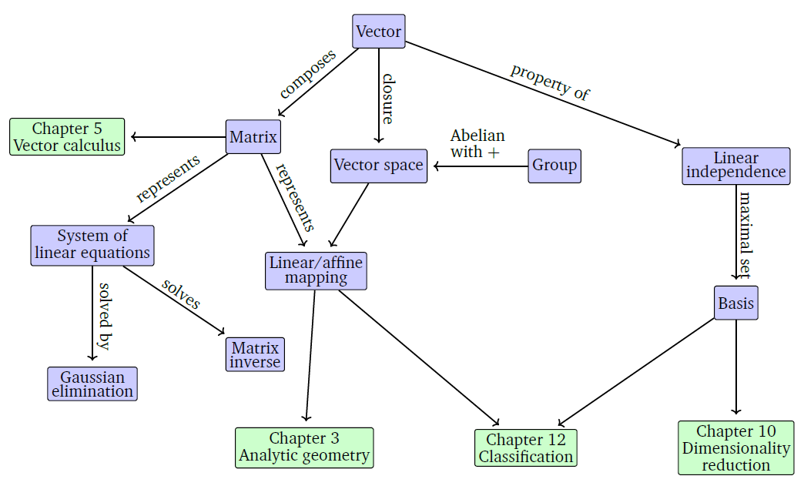
A mind map of the concepts of linear algebra
Source: Mathematics for Machine Learning, by Marc Peter Deisenroth, A. Aldo Faisal, Cheng Soon Ong

Slide 6
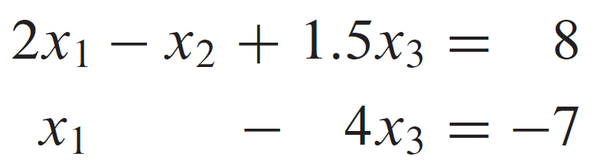
Systems of Linear Equation
A system of linear equations (or a linear system) is a collection of one or more linear equations involving the same variables—say, x₁, x₂, …, x_{n} . An example is
Source: Linear Algebra and its applications by David C. Lay, Steven R. Lay, Judi J. McDonald, Pearson, Fifth Edition

Slide 7
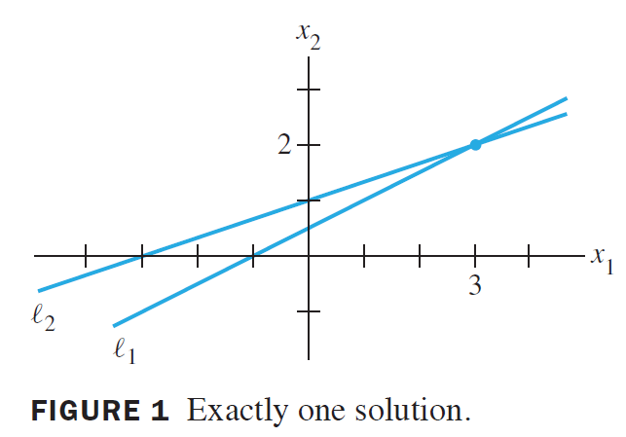
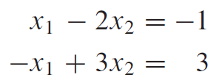
A solution of the system
consistent
Source: Linear Algebra and its applications by David C. Lay, Steven R. Lay, Judi J. McDonald, Pearson, Fifth Edition

Slide 8
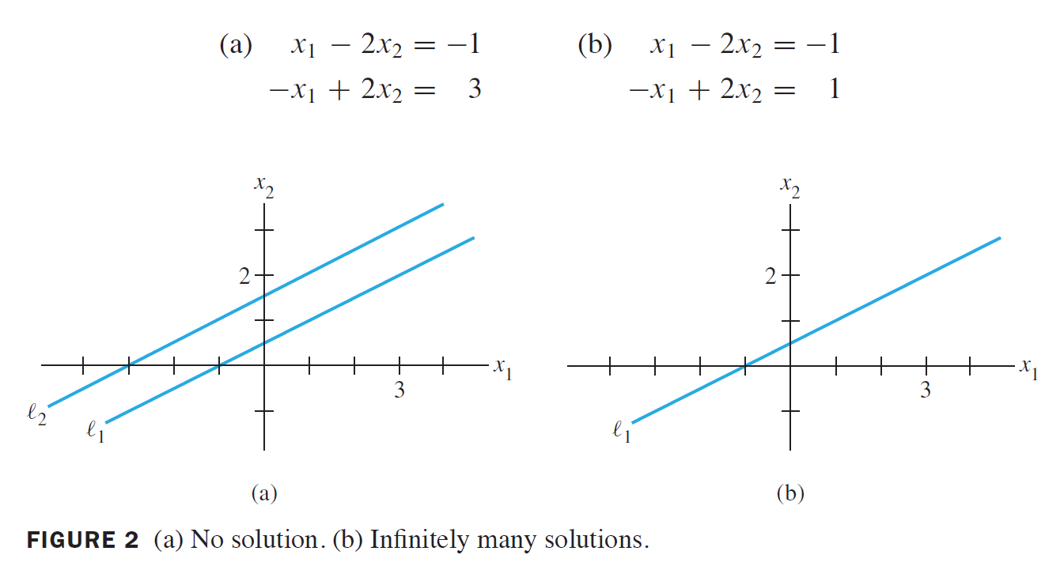
A solution of the system
inconsistent
consistent
Source: Linear Algebra and its applications by David C. Lay, Steven R. Lay, Judi J. McDonald, Pearson, Fifth Edition

Slide 9
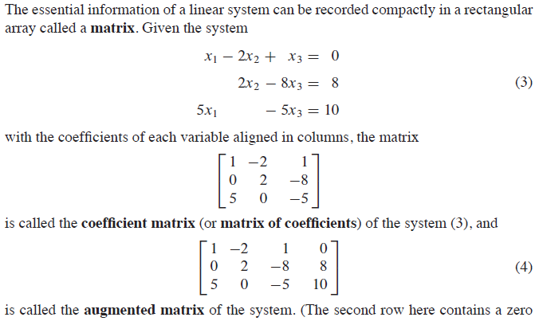
Matrix Notation
Source: Linear Algebra and its applications by David C. Lay, Steven R. Lay, Judi J. McDonald, Pearson, Fifth Edition

Slide 10
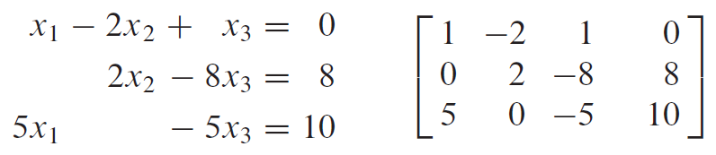
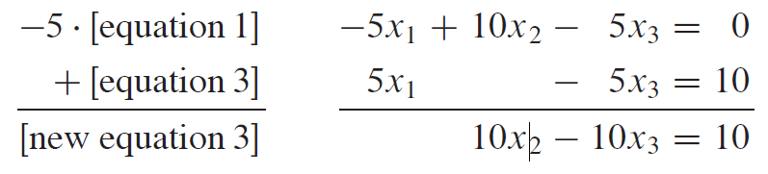
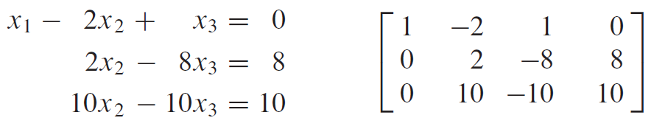
Solving a linear system - elimination
Source: Linear Algebra and its applications by David C. Lay, Steven R. Lay, Judi J. McDonald, Pearson, Fifth Edition

Slide 11
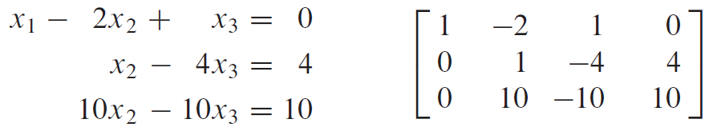
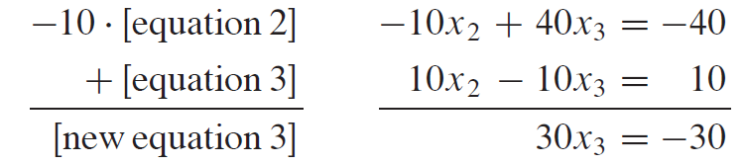
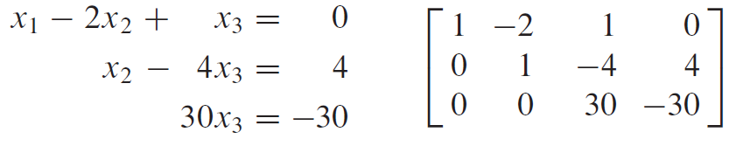
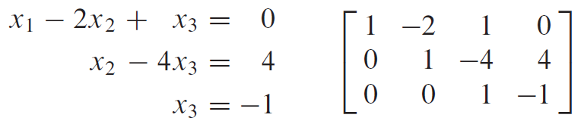
Solving a linear system - elimination
Source: Linear Algebra and its applications by David C. Lay, Steven R. Lay, Judi J. McDonald, Pearson, Fifth Edition

Slide 12
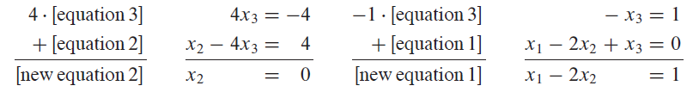
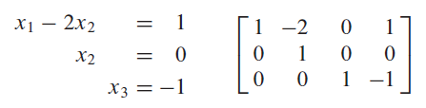
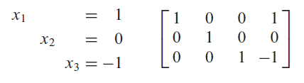
Solving a linear system - elimination
Source: Linear Algebra and its applications by David C. Lay, Steven R. Lay, Judi J. McDonald, Pearson, Fifth Edition

Slide 13
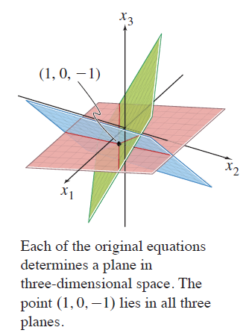
Solving a linear system - elimination
Source: Linear Algebra and its applications by David C. Lay, Steven R. Lay, Judi J. McDonald, Pearson, Fifth Edition

Slide 14
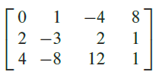
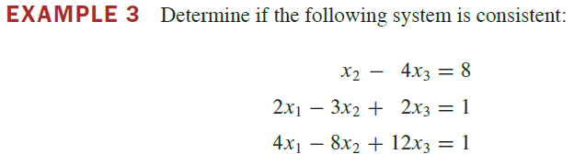
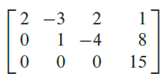
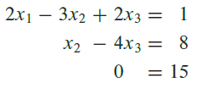
Existence and Uniqueness
Source: Linear Algebra and its applications by David C. Lay, Steven R. Lay, Judi J. McDonald, Pearson, Fifth Edition

Slide 15
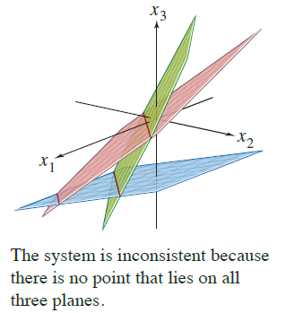
Existence and Uniqueness
Source: Linear Algebra and its applications by David C. Lay, Steven R. Lay, Judi J. McDonald, Pearson, Fifth Edition

Slide 16
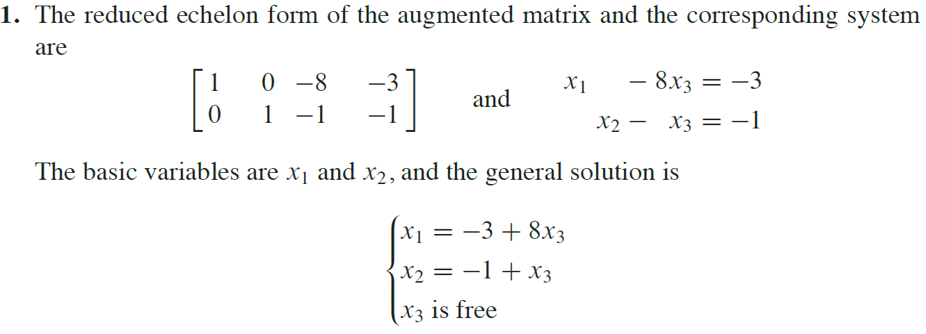
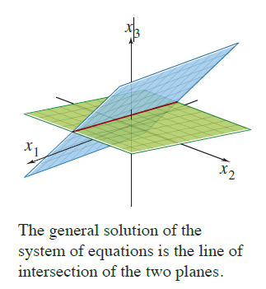
Existence and Uniqueness
Source: Linear Algebra and its applications by David C. Lay, Steven R. Lay, Judi J. McDonald, Pearson, Fifth Edition

Slide 17






Exercise – linear system
Please solve below linear systems and submit the answer to LMS
(select 1/2/3 or 4/5/6)
1. 2. 3.
4. 5. 6.
$$x_{1} −3x_{2} =5$$
$${−x}_{1}+x_{2}+5x_{3}=2$$
$${ x}_{2} + x_{3}=0$$
$${2x}_{1}+x_{2}+4x_{2}=−1$$
$$x_{1}+x_{2}+x_{3}=−1$$
$$x_{1}{−x}_{2}+{5x}_{3}=1$$
$$x_{1}+ x_{3} =1$$
$${−x}_{1}+x_{2} =0$$
$$x_{2}+x_{3}=0$$
$${2x}_{1}−2x_{2}+4x_{2} =0$$
$$x_{1}−2x_{2}+x_{3}=−5$$
$$3x_{1}{−2x}_{2}+{5x}_{3}=7$$
$$x_{1}+ 3x_{3} =4$$
$$x_{1}+x_{2}+x_{3}=7$$
$${−x}_{2}+{2x}_{3}=−3$$
$$x_{1}+x_{2}+{2x}_{3}=1$$
$$x_{1}+ x_{3}=0$$
$$x_{2}+x_{3}=0$$

Slide 18
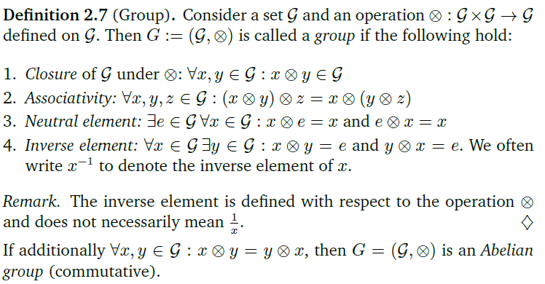
Group – Definition**
Source: Mathematics for Machine Learning, by Marc Peter Deisenroth, A. Aldo Faisal, Cheng Soon Ong

Slide 19
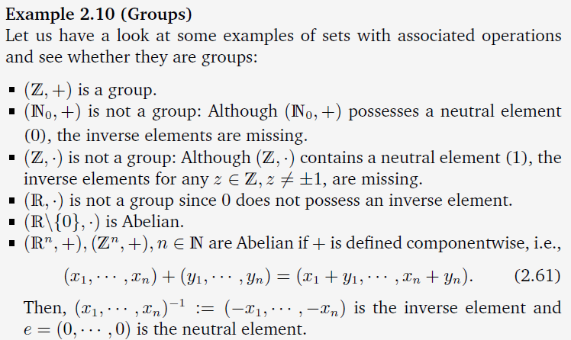
Group – Examples**
Source: Mathematics for Machine Learning, by Marc Peter Deisenroth, A. Aldo Faisal, Cheng Soon Ong

Slide 20
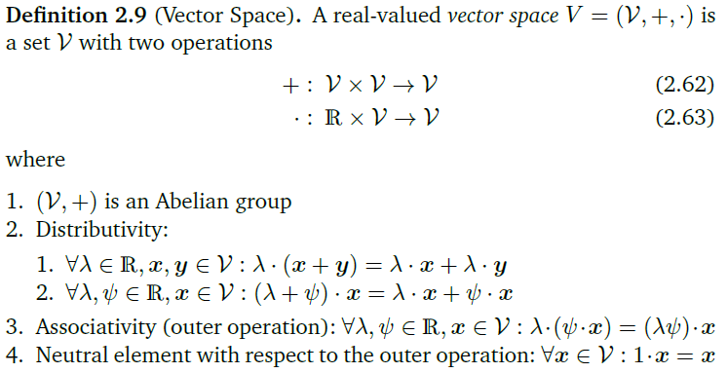
Vector Space
Source: Mathematics for Machine Learning, by Marc Peter Deisenroth, A. Aldo Faisal, Cheng Soon Ong

Slide 21
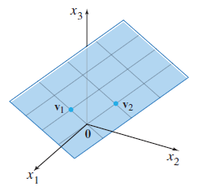
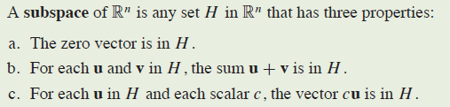
Vector Subspace
Source: Linear Algebra and its applications by David C. Lay, Steven R. Lay, Judi J. McDonald, Pearson, Fifth Edition

Slide 22
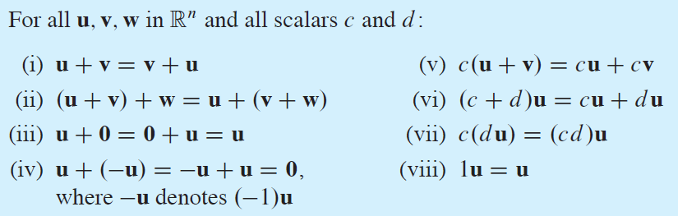
Vector Space - R^{n}
A vector space is a non-empty set V together with two binary operations that satisfy the eight axioms listed below.
Source: Linear Algebra and its applications by David C. Lay, Steven R. Lay, Judi J. McDonald, Pearson, Fifth Edition

Slide 23

Linear Combination
Given vectors v₁, v₂, …, v_{p} in R^{n} and given scalars c₁, c₂, …, c_{p},
The vector y defined by
is called a linear combination of v₁, v₂, …, v_{p} with weights c₁, c₂, …, c_{p}
Source: Linear Algebra and its applications by David C. Lay, Steven R. Lay, Judi J. McDonald, Pearson, Fifth Edition

Slide 24
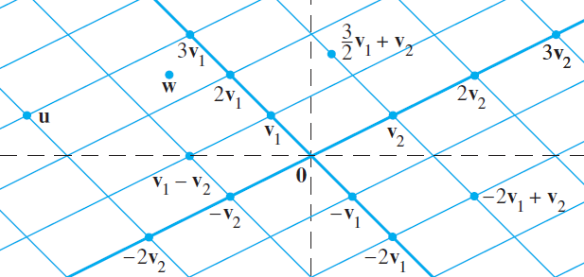
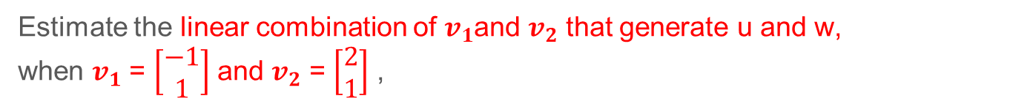
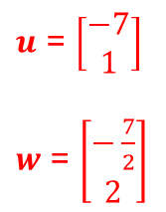
Linear Combination
Estimate the linear combination of $v_{1}$and $v_{2}$ that generate u and w,
when $v_{1}$ = $\left[\begin{matrix}−1 \\ 1\end{matrix}\right]$ and $v_{2}$ = $\left[\begin{matrix}2 \\ 1\end{matrix}\right]$ ,
$u$ = $\left[\begin{matrix}−7 \\ 1\end{matrix}\right]$
$w$ = $\left[\begin{matrix}−\frac{7}{2} \\ 2\end{matrix}\right]$
Source: Linear Algebra and its applications by David C. Lay, Steven R. Lay, Judi J. McDonald, Pearson, Fifth Edition

Slide 25
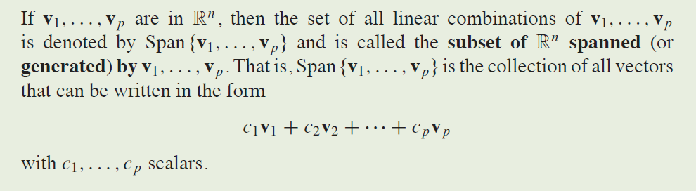
Linear Combination and Span
Source: Linear Algebra and its applications by David C. Lay, Steven R. Lay, Judi J. McDonald, Pearson, Fifth Edition

Slide 26
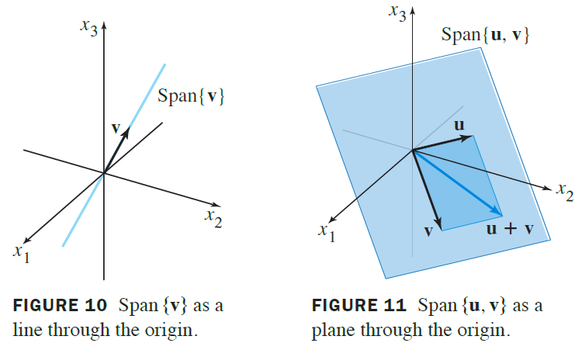
Geometric description of Span{v} and Span{u, v}
u and v are nonzero vectors in R³, which are not scalar multiple of the others.
Source: Linear Algebra and its applications by David C. Lay, Steven R. Lay, Judi J. McDonald, Pearson, Fifth Edition

Slide 27
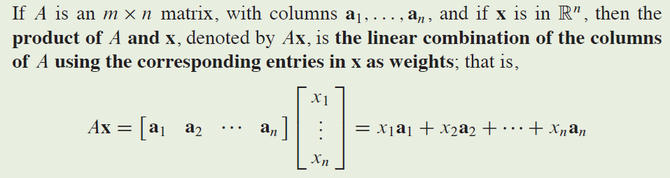
The Matrix Equation Ax=b
A fundamental idea in linear algebra is to view a linear combination of vectors as the product of a matrix and a vector.
Source: Linear Algebra and its applications by David C. Lay, Steven R. Lay, Judi J. McDonald, Pearson, Fifth Edition

Slide 28
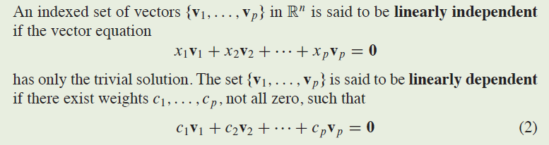
Linear Dependency
Source: Linear Algebra and its applications by David C. Lay, Steven R. Lay, Judi J. McDonald, Pearson, Fifth Edition

Slide 29
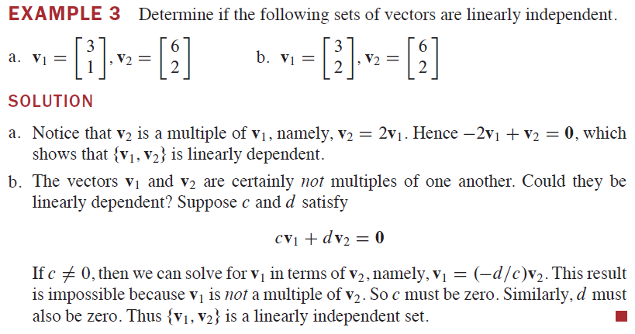
Linear Dependency – 2-d Example
Source: Linear Algebra and its applications by David C. Lay, Steven R. Lay, Judi J. McDonald, Pearson, Fifth Edition

Slide 30
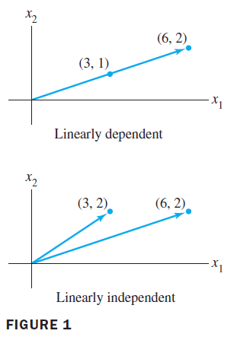
Linear Dependency – 2-d Example
Source: Linear Algebra and its applications by David C. Lay, Steven R. Lay, Judi J. McDonald, Pearson, Fifth Edition

Slide 31
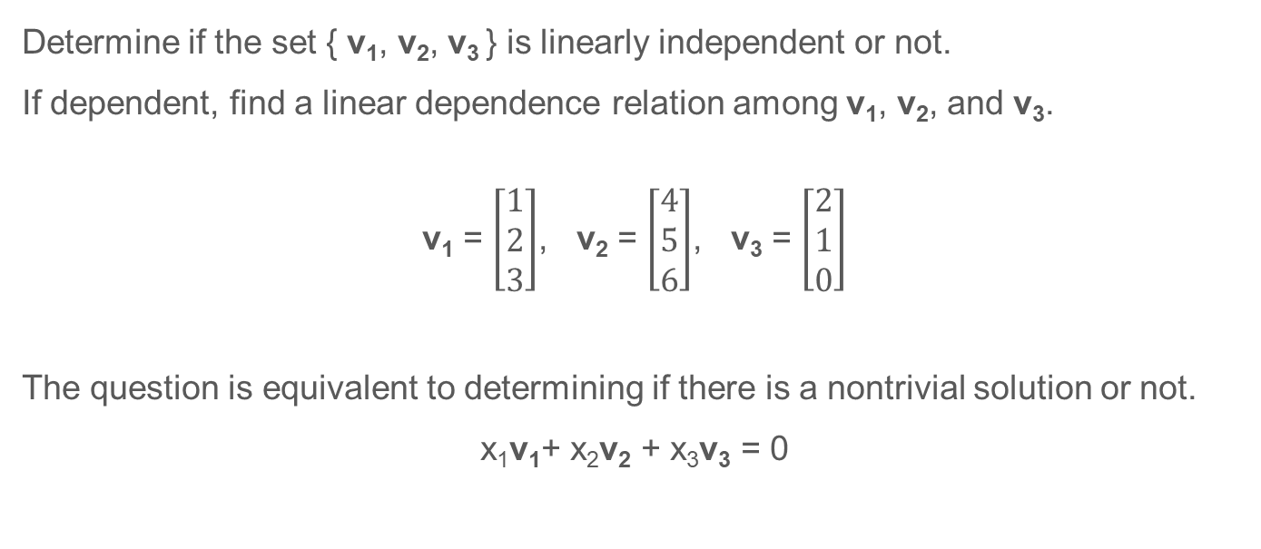
Linear Dependency – 3-d Example 1
Determine if the set { v₁, v₂, v₃ } is linearly independent or not.
If dependent, find a linear dependence relation among v₁, v₂, and v₃.
v₁ = $\left[\begin{matrix}1 \\ 2 \\ 3\end{matrix}\right]$, v₂ = $\left[\begin{matrix}4 \\ 5 \\ 6\end{matrix}\right]$, v₃ = $\left[\begin{matrix}2 \\ 1 \\ 0\end{matrix}\right]$
The question is equivalent to determining if there is a nontrivial solution or not.
x₁v₁+ x₂v₂ + x₃v₃ = 0
Source: Linear Algebra and its applications by David C. Lay, Steven R. Lay, Judi J. McDonald, Pearson, Fifth Edition

Slide 32
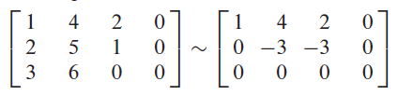
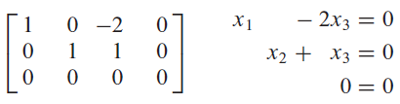
Linear Dependency – 3-d Example 1
The question is equivalent to determining if there is a nontrivial solution or not.
x₁v₁+ x₂v₂ + x₃v₃ = 0
x₃ is free variable, → non-trivial solution exist → v₁, v₂, v₃ are linearly dependent.
If we set x₃ as 1, x₂ = -1, x₁ = 2
x₁v₁+ x₂v₂ + x₃v₃ = 0 ➔ 2v₁ - v₂ + v₃ = 0
Source: Linear Algebra and its applications by David C. Lay, Steven R. Lay, Judi J. McDonald, Pearson, Fifth Edition

Slide 33
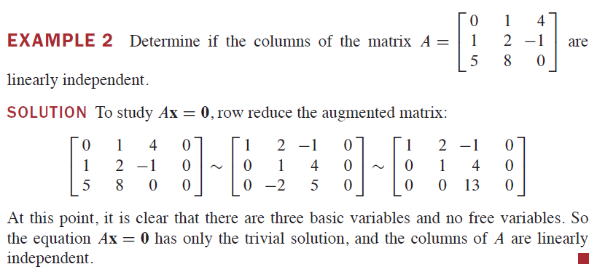
Linear Dependency – 3-d Example 2
Source: Linear Algebra and its applications by David C. Lay, Steven R. Lay, Judi J. McDonald, Pearson, Fifth Edition

Slide 34
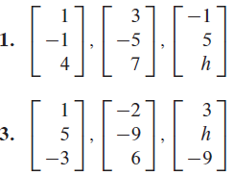

Exercise – linear dependence
Please find the values(s) of h for which the vectors are linearly dependent. (choose 2 problems to solve and submit the answer)

Slide 35
Generating Set and Basis
Definition 2.13 (Generating Set and Span).
Consider a vector space V = (V,+,·) and set of vectors A = {x₁, …, x_{k}} ⊆ V.
If every vector v ∊ V can be expressed as a linear combination of x₁, …, x_{k},
A is called a generating set generating set of V .
The set of all linear combinations of vectors in A is called the span of A.
If A spans the vector space V , we write V = span[A] or V = span[x₁, …, x_{k}].
Source: Mathematics for Machine Learning, by Marc Peter Deisenroth, A. Aldo Faisal, Cheng Soon Ong

Slide 36


Generating Set and Basis
Source: Mathematics for Machine Learning, by Marc Peter Deisenroth, A. Aldo Faisal, Cheng Soon Ong

Slide 37

Generating Set and Basis
Source: Linear Algebra and its applications by David C. Lay, Steven R. Lay, Judi J. McDonald, Pearson, Fifth Edition

Slide 38


Rank
Source: Mathematics for Machine Learning, by Marc Peter Deisenroth, A. Aldo Faisal, Cheng Soon Ong

Slide 39



Linear Transformations
~
Matrix equation has other implications than linear combination
in the areas of computer graphics or signal processing.
The matrix A as a “function” on a vector x, to produce a new vector b.
Source: Linear Algebra and its applications by David C. Lay, Steven R. Lay, Judi J. McDonald, Pearson, Fifth Edition

Slide 40

Linear Transformations
Source: Linear Algebra and its applications by David C. Lay, Steven R. Lay, Judi J. McDonald, Pearson, Fifth Edition

Slide 41

Matrix Representation of Linear Mapping
Source: Mathematics for Machine Learning, by Marc Peter Deisenroth, A. Aldo Faisal, Cheng Soon Ong

Slide 42

Linear Transformations
A transformation (or function or mapping) T from R^{n} to R^{m} is a rule that assigns
each vector x in R^{n} to a vector T(x) in R^{m}.
R^{n} : Domain (정의역)
R^{m} : Codomain (공변역)
T(x) : image(상) of x
{ T(x) } : Range(치역) of T
Source: Linear Algebra and its applications by David C. Lay, Steven R. Lay, Judi J. McDonald, Pearson, Fifth Edition

Slide 43
Exercise – Rank and Dimension
Study and Explain Rank and Dimension of given matrix A ∊ R^{mxn}

Slide 44
Homework
Read Chapter 3. Analytic Geometry

Slide 45
Next Week
Analytic Geometry
Inner Product, Norms, Lengths and Distances
Orthogonality, Orthogonal Projections

Slide 46
BongGyun Kim
Office hour: Mon. 2pm ~ 6pm
@ room 231, building W19
Phone: 042-629-6636
Mobile: 010-6799-6636
bonggyun.kim@endicott.ac.kr

Slide 47
End of Week 2

